Slide 1

Heart Disease Detection
Using ECG Images

Slide 2
Abstract
Heart disease is a prevalent and life-threatening condition that affects the millions of people worldwide
This abstract focuses on the Heart disease detection using deep learning algorithms.

Slide 3
Libraries Required
Importing the required libraries
Numpy
pandas
Tensorflow. Keras
Matplotlib
Seaborn
Scikit and SciPy

Slide 4
Flow Diagram Of Heart Disease Detection
Data Collection
Data Preprocessing
Model Selection
Model Tuning
Model Evaluation
Model Training
Prediction

Slide 5
ECG Image Classification Project Architecture
Input ECG Image
Convolution Layer
Pooling Layer
ReLU Activation function
Flatting
Weight & Bias
Fully Connected Layer
Output

Slide 6
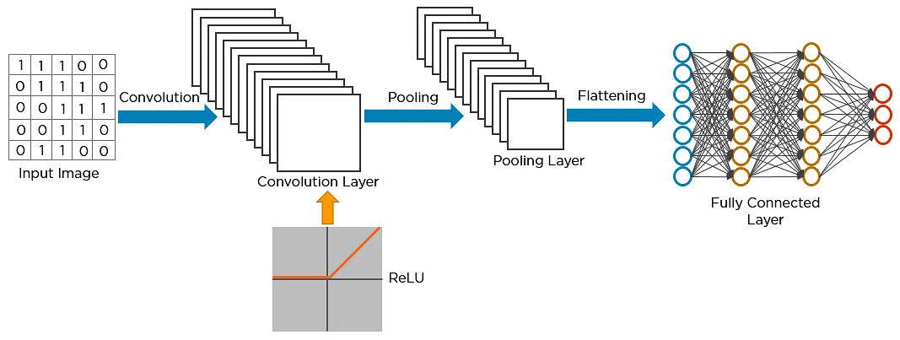

Slide 7
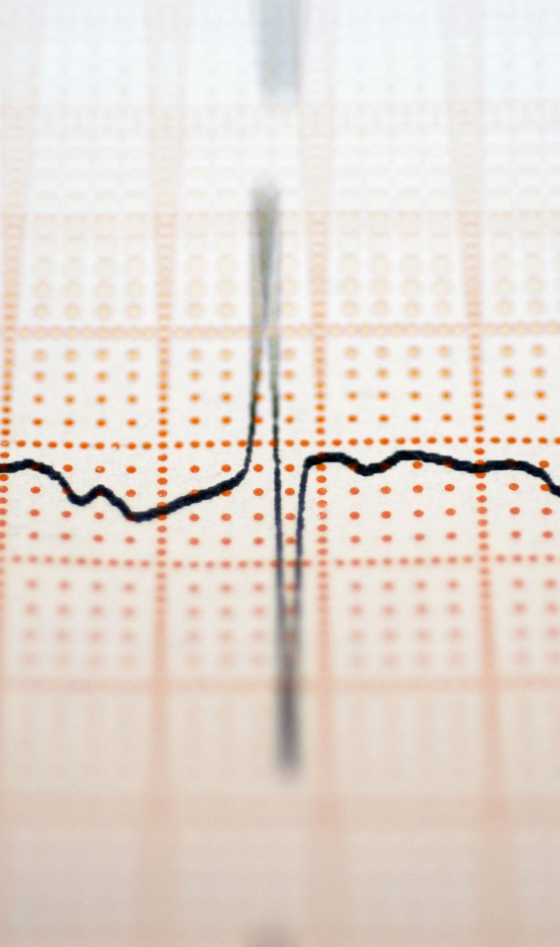
Here is an outline of the steps involved in ECG image classification.
1.Data Collection: Gather a dataset of images relevant to the normal Heartrate person ECG images and abnormal Heartrate person ECG images.
2.Data Preprocessing: Prepare the dataset for training by performing various preprocessing steps and Combine the normal person and abnormal person dataset and splitting the dataset into training and testing sets.

Slide 8
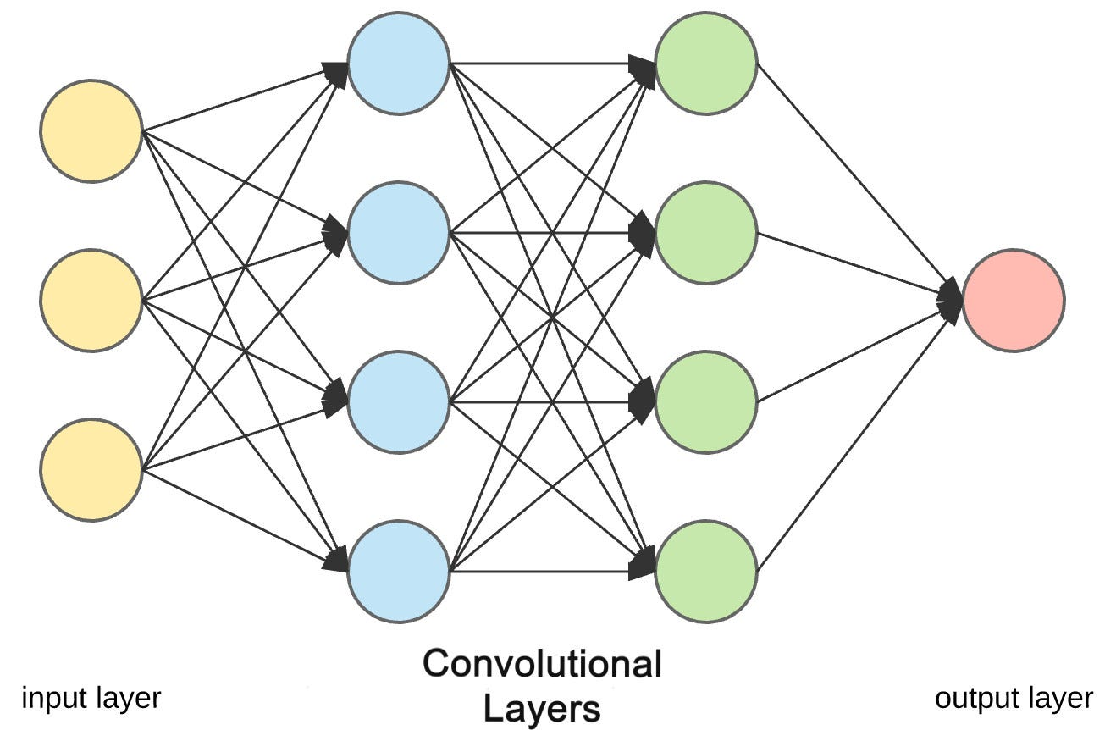
Model selection: Selecting the deep learning model CNN. By consider CNN best for the image classification.

Slide 9
Pooling Layer: -Pooling layers are one of the building blocks of Convolutional Neural Networks. Where Convolutional layers extract features from images, Pooling layers consolidate the features learned by CNNs. Its purpose is to gradually shrink the representation’s spatial dimension to minimize the number of parameters and computations in the network.
Flatten Layer:-Flattening is used to convert all the resultant 2-Dimensional arrays from pooled feature maps into a single long continuous linear vector. The flattened matrix is fed as input to the fully connected layer to classify the image.

Slide 10
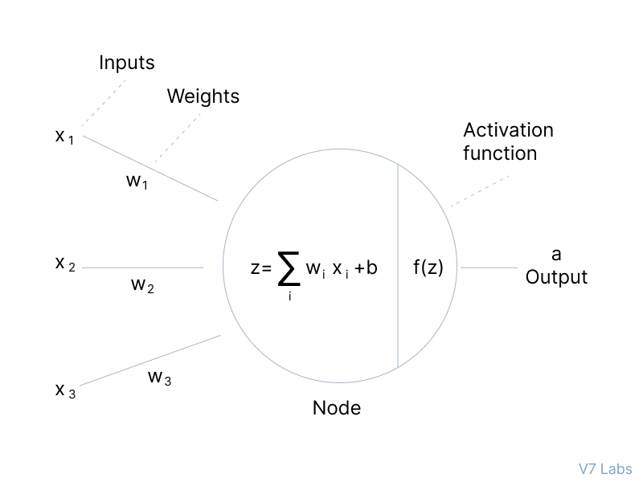
The algorithm initialization of weights by the neural network and add the bias to the hidden layer . In the hidden layer two operation are done . One is summation of input layer and weights and another one is activation function.

Slide 11
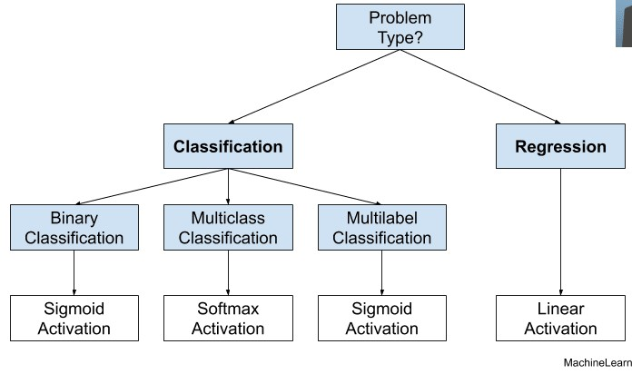
Your data was multiclass classification problem we considering the either sigmoid and SoftMax activation function

Slide 12
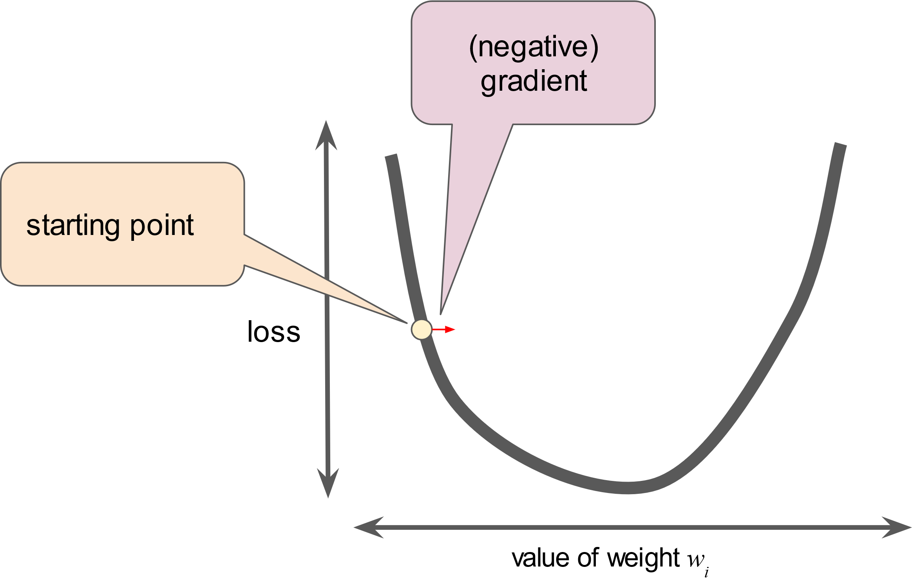
SoftMax Activation Function:- SoftMax classifiers give you probabilities for each class label. It’s range of 0 to 1 and assign the probabilities of each possible outcome.
Loss Function:-After completed the forward propagation check the loss function (predicted value – actual value) or Gradient decent.

Slide 13
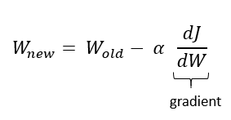
The loss function should be minimum to zero and if loss function not minimum to zero we need to do the back propagation.
Back propagation update the weights of hidden layer to output layer and input layer to hidden layer.
By updating the weights formula

Slide 14
W new = New weight
W old = Old weight
α = learning rate
dj = derivative slope of the point.
Model training: Splitting the data into training set and testing set . Train the model using the training set.
Model Evaluation: Evaluate the training set using the testing dataset and check the performance of the model accuracy and recall and f1score.

Slide 15
Model-Tuning: Tuning the model for the better accuracy by using the hyperparameter and changing the optimizer.
Predictions on New Images: Once the model is trained and evaluated, it can be used to make predictions on new, unseen images. The model takes an input image, processes it, and assigns it to one of the predefined classes.

